Slide 1
SSIE 637
Advanced Topics in Healthcare
Lecture #1

Slide 2
Course Info.
Instructor: Daehan Won
My office: EB R4
Office hours: T, R 2:00~3:30 PM (or by appointment)
Email: dhwon@binghamton.edu
TA: Dieudonne N Ouedraogo
Office: EB T3
Office hours: Thu 10:00~2:00 PM
Email: douedra1@binghamton.edu
Prerequisites:
SSIE537 and ISE437
Statistical analysis (+ basic operations research)
Programming skills

Slide 3
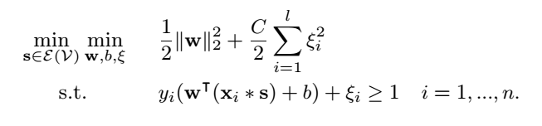
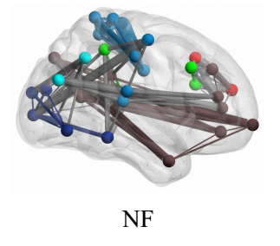
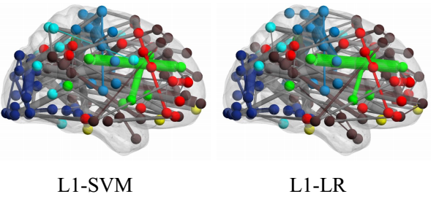
Instructor
BS & MS, ISE, Korea Advanced Institute of Science and Technology, S.Korea
Ph.D., ISE, Univ. of Washington, Seattle WA
Research Interest
Mathematical modeling (Linear / Integer programming, convex opt)
Data Mining / Machine learning on large scale data
Computation / Algorithm developments
Healthcare informatics, logistics, scheduling

Slide 4
Course Info.
Deals with several topics in healthcare system including healthcare data analysis, decision making on medicine, healthcare management (logistics)
Learn how to utilize quantitative methodologies/techniques in data mining to solve real world application problems in healthcare / biomedicine.
Healthcare topics
Data mining techniques in healthcare / medical applications
IE / OR methodologies

Slide 5
Grade
Assignments 30%
Paper reading + presentation 15%
Midterm exam 25%
Final report 30%
No late submission
Notify the instructor in advance via email / phone regarding any emergency cases

Slide 6
Assignments
Problem questions
Short essay writing
Basic programming
Paper reading / Presentation
Review 3 papers
10 min presentation in class
Brief essay (2~3 pages)
Introduction (motivation + contribution)
Problem definition / Literatures
Methods
Significance
Your comments (idea?)

Slide 7
Paper reading / Presentation
Selection
From high impact journals, e.g., INFORMS, IEEE, Health Management Science, IIE transaction on Healthcare System Eng.
Try to avoid conference papers (But, low acceptance rate case will be ok)
Please provide a journal two days before
Submission
Presentation slide must be submit by 12pm at the day when you present
Submit essay when you present
Enginet students may have a separate deadline
Collection efficiency, please set names of your files as follows
Paper file is named with paper title ex) An Interpretable Stroke Prediction Model using Rules and Bayesian Analysis
Essay should be “daehan won_paper_summary_01”
Slide should be “daehan won_presentation_01”

Slide 8
Referred Journals
Healthcare Management Science
Operations Research for Healthcare
IIE transactions on Healthcare Systems Engineering
Computer and Operations Research
Expert Systems with Applications
IEEE journals (ex. IEEE Biomedical and Health informatics)
BMC journals (ex. Medical Informatics and Decision Making)
INFORMS journals
PlosOne
…

Slide 9
Midterm Exam
Topics taught in class
Closed book & notes
3 hours
Final Project
Important. What you have done → completion of final project
Report
ISERC conference paper version (10 pages / Latex)
15 min oral presentation

Slide 10
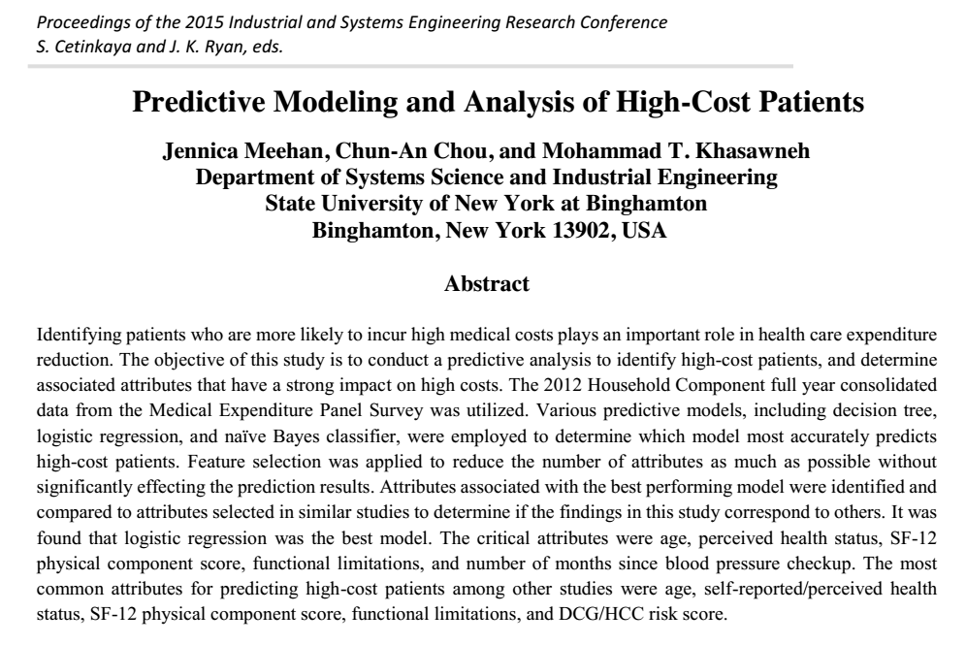
Examples

Slide 11
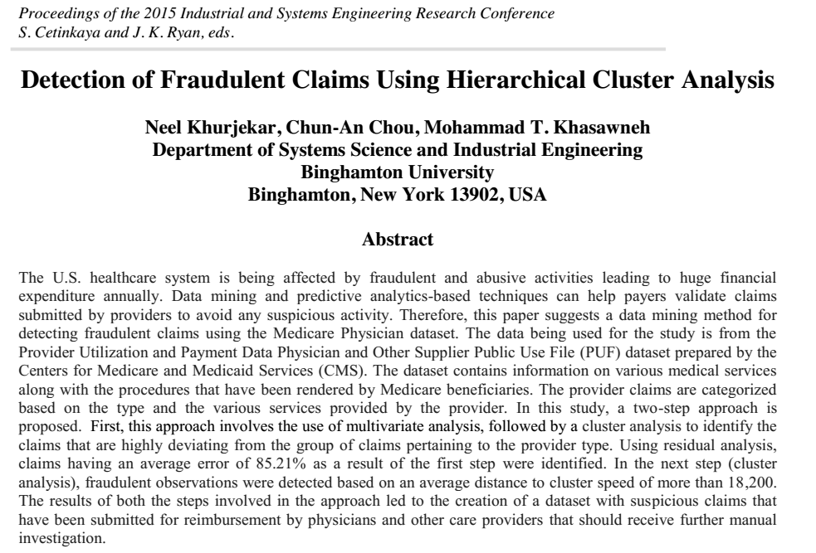

Slide 12
Policy
Participation : required to fully participated in the class
Attendance: to attend every class
Reading assignment: strongly encouraged to read assignment
Academic honesty: Will be abide by Binghamton University’s policy on academic honesty listed in the university bulletin

Slide 13
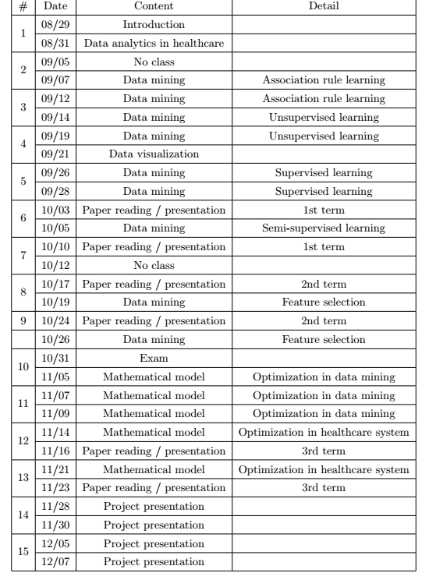

Slide 14
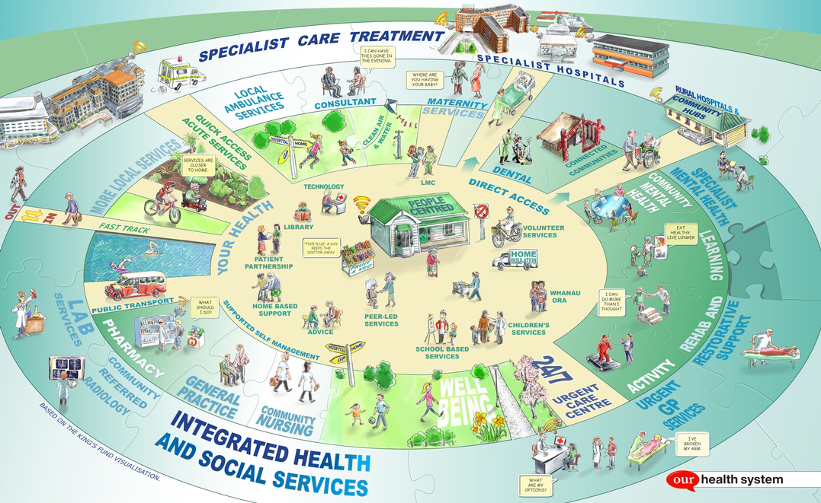
Introduction
Health System

Slide 15
Introduction
Health System
Organization + people + actions
Primary intent is to promote, restore or maintain health
Including effort to influence determinants of health as well as more direct health improving activity
Hospital
An organization devoted to delivering patient care
Central hub
A “facility” to serve those who need overnight stay or surgery
Provided services
Observation: analyzing or studying patients and running test
Diagnosis: explanation of doctors for the cause of the symptoms
Treatment: action to make patients better ( lessen the symptoms / pains)

Slide 16
Aims for Improvement of System
Safety | Avoiding injuries to patients from the care that is intended to help them
Effective | Providing services based on the scientific knowledge to all who could benefit and refraining from providing services to those not likely to benefit ( avoiding underuse / overuse)
Patient-centered | Providing care that is respectful of and responsive to individual patient preferences, needs and values
Timely | Reducing waits and harmful delays (sometimes)
Efficient | Avoiding waste, including waste of equipment, supplies, and energy
Equitable | Providing care that does not vary in quality because of personal characteristics such as gender, ethnicity, geographic, and economic status
(Building a better delivery system a new engineering / healthcare partnership,2005)

Slide 17
Healthcare Business
Hospitals
Non profit organizations with focus on more abstract goals of improving health or curing + eliminating disease
Performance outcome is primarily measured by mortality and morbidity indicator. Lack of financial metric
Lack of formal training in business management
Other business
Maximizing profit and satisfying stakeholders
Performance is measured by business factors such as economic values, return rate on investment.
Professional training and education in all aspect

Slide 18
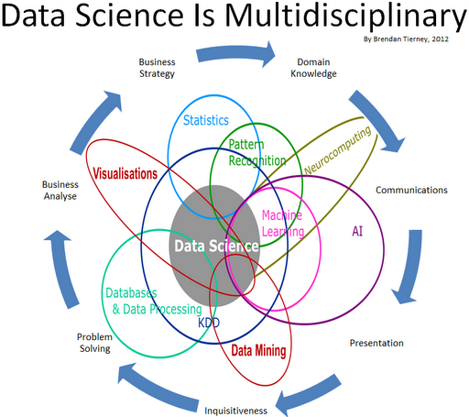
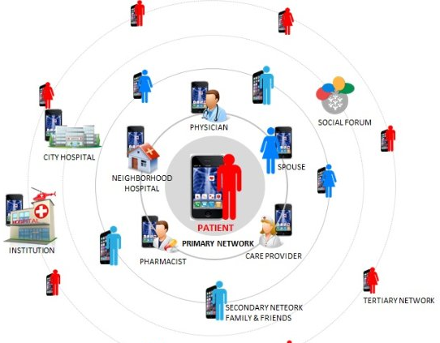
Healthcare Analytics
Data Mining is used to discover patterns in healthcare data
Mathematical modeling is to solve pattern discovery problems systematically
Objective is to aid decision making with accurate information and interpretation
Prasant Parida, IBM, 2016

Slide 19
Healthcare Analytics
The business of healthcare is closely connected to the evolving science of medicine and role of individual consumers (patients)
It builds the case for a fairly singular idea; that using health related information in new and creative ways to
Lower cost
Enhance profitability
Improve patient outcomes
Grow customer intimacy
Drive medical innovation

Slide 20
Healthcare Operations Management
Integrate scientific principles of management to determine the most efficient and optimal methods to support healthcare delivery
A quantitative management (by use of analytic and optimization tools) of the supporting business (healthcare) systems and process that transform resources (inputs) into health services(output)
Input: labor, capital, technology, resources, space, etc.
Output: actual production and delivery of services

Slide 21
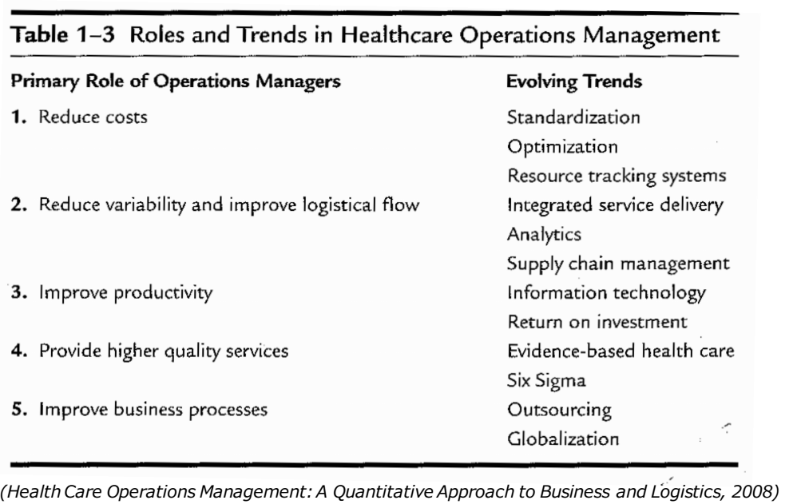
Trends

Slide 22
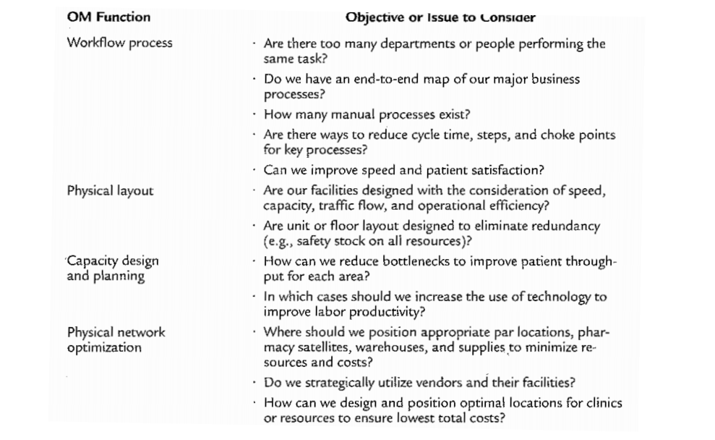
Key functions in HOM

Slide 23
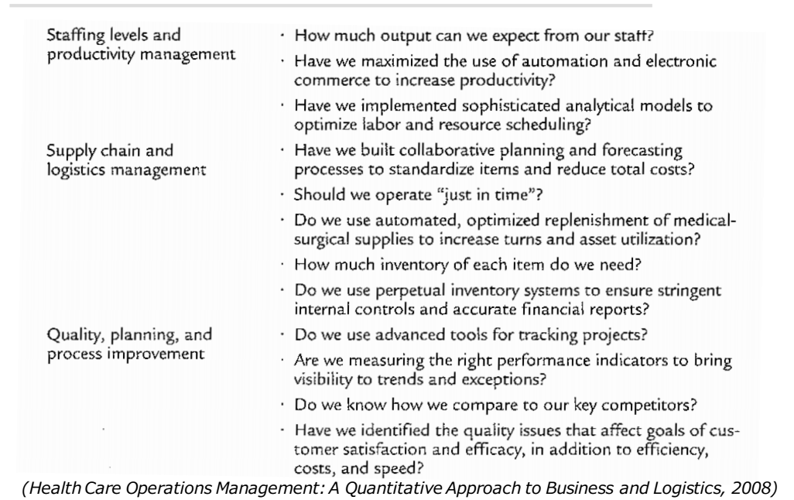
Key functions in HOM

Slide 24

Urgent issues of healthcare system improvements in terms of engineering and technologies domain
New payment system
Data access / analysis
….

Slide 25

Hospital admission scheduling and control problem
Patients census modeling
Develop a new method based on semi-markov model-> clustering

Slide 26
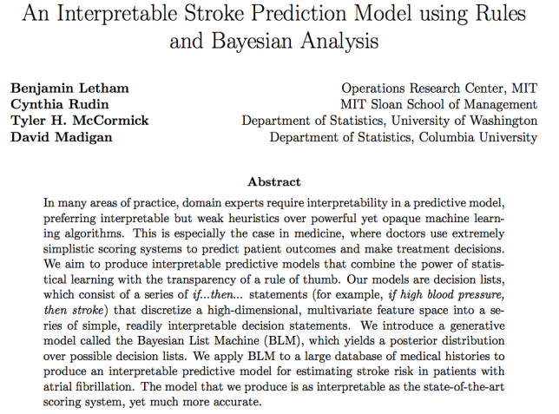

Slide 27
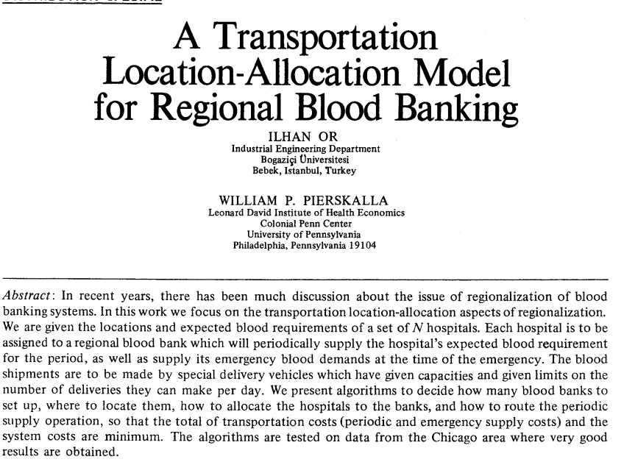
Classical paper
Bloodbank allocation problem.
How to allocate bloodbanks to meet the requirements of hospitals

Slide 29
Questions?

